Slide 1
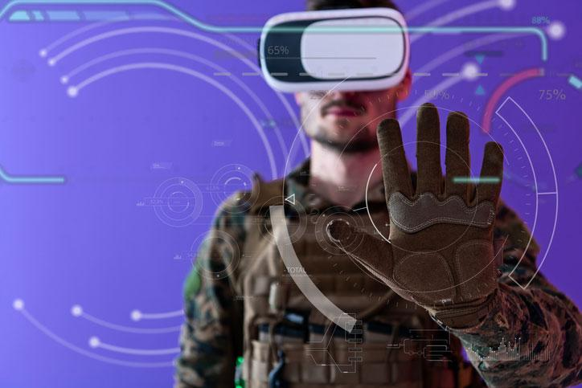
Fintech Project -1
Effects of Pandemic

Slide 2




Contributors
Alpa Sheladia
Shrey Dudhia
Will Turner
Brandon Srinath

Slide 3
Inspiration
Covid-19 has affected all of our lives in many different way. Likewise, the pandemic has impacted many industries big and small. Airline industry’s struggles were more acute than many other industries. As the pandemic progressed, 40-80% fewer flights were being used. Hence, We felt that it was important to analyze and create visualization.

Slide 4
Pandemic Problem
We wanted to illustrate how Covid-19 has impacted various industries as whole. As we know, the airline industry was hit hard from the beginning, whereas tech industry didn’t do so bad. In fact, tech company like Amazon and Apple did quite well. Likewise, S&P 500 had nearly recovered not only recovered most of the losses suffered during Pandemic but it reached new height according to Wall street journal. However, currently it went down. Our analysis proves that currently most industries are facing volatility and an unstable market with the exception of the Tech industry.

Slide 5
Design Process
Our project required conducting a financial analysis on top 5 industry-focused portfolios of airlines, top 5 tech companies and S&P 500 data to properly provide an accurate analysis of how Covid-19 affected it's future including the stock market data. We needed quarterly data for two years from 2019 to current quarter of 2020.
We imported APIs and datasets using various resources and displayed information the json files.
We chose to convert Json files to csv dataframe for more readable format to provide the functionality component, and ease of usage to start actual coding for the project.

Slide 6
Framework
With a help from pandas library and from_dict function we built quarterly reports of all the companies.
We clean data using arrays and separated columns needed .
Although, we were having limited access of data from Alpha Vantage and had to wait in order to run codes again. We solved the problem by importing new library called "Time" and included “time.sleep(60) “ so that code can wait 60 seconds upon encountering an error.

Slide 7
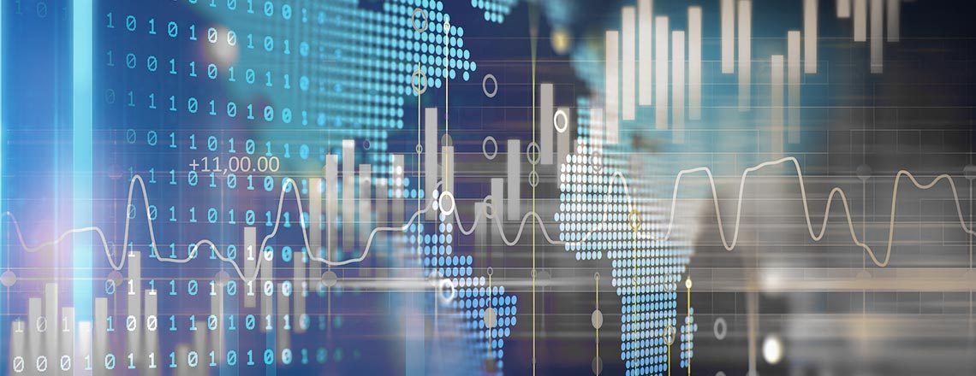
The
Denouement

Slide 8
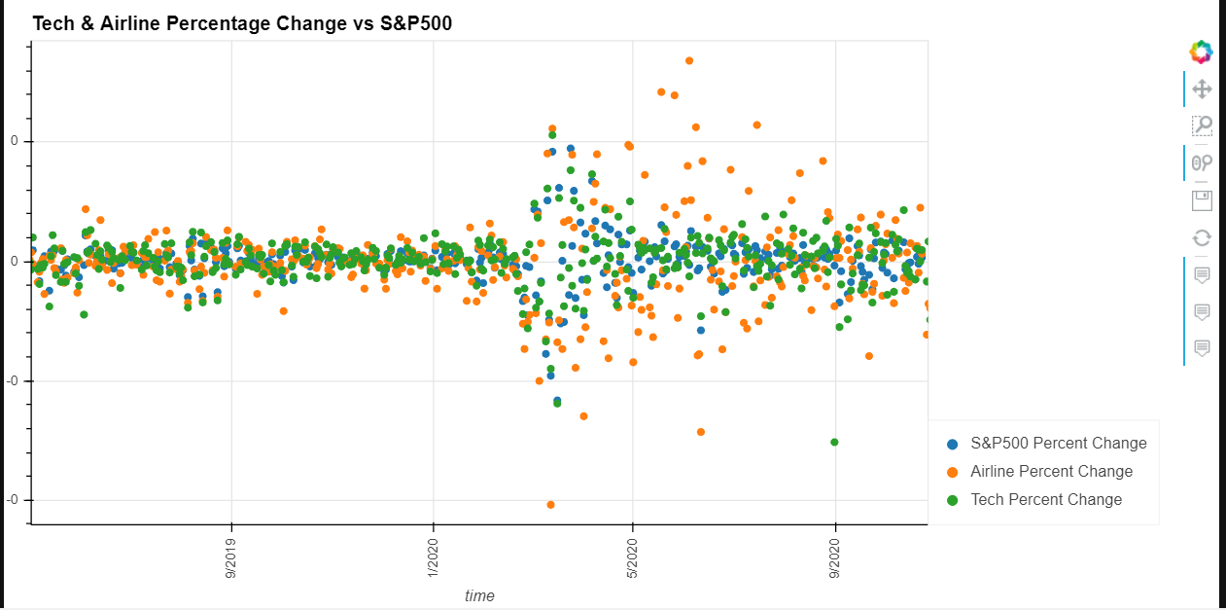
Increased volatility with the start of COVID-19

Slide 9
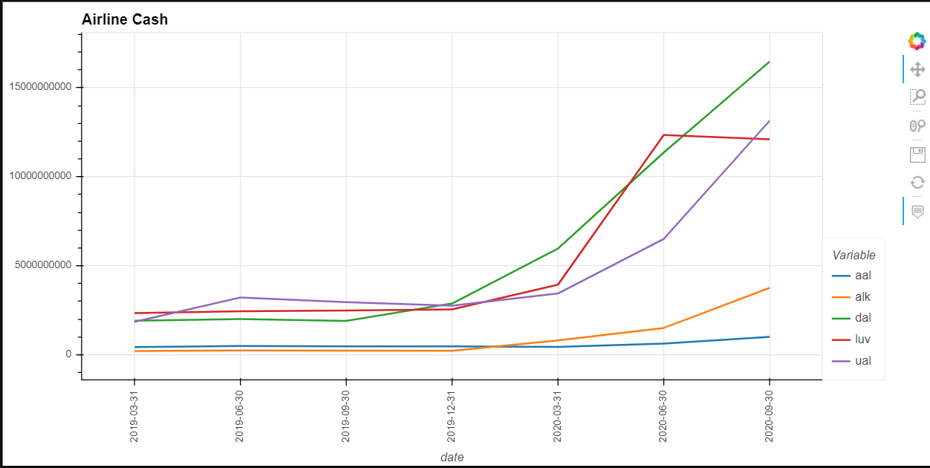
Airlines being pumped with cash

Slide 10
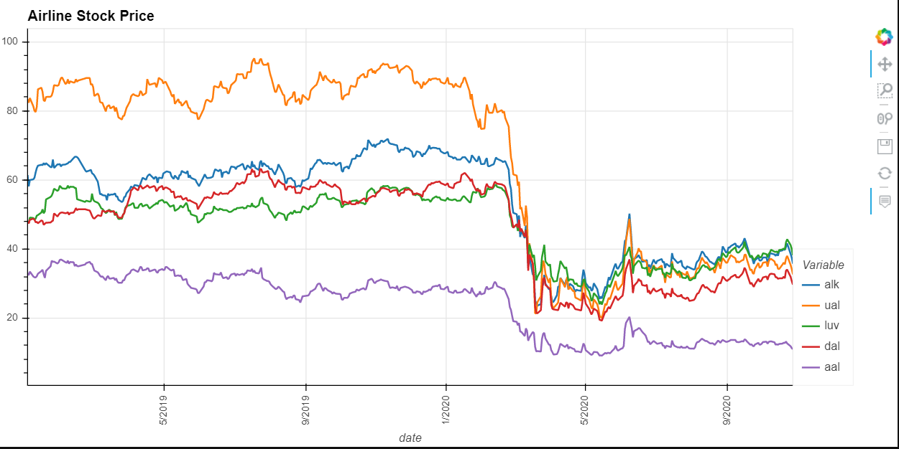
Airline stock prices dropping after COVID-19

Slide 11
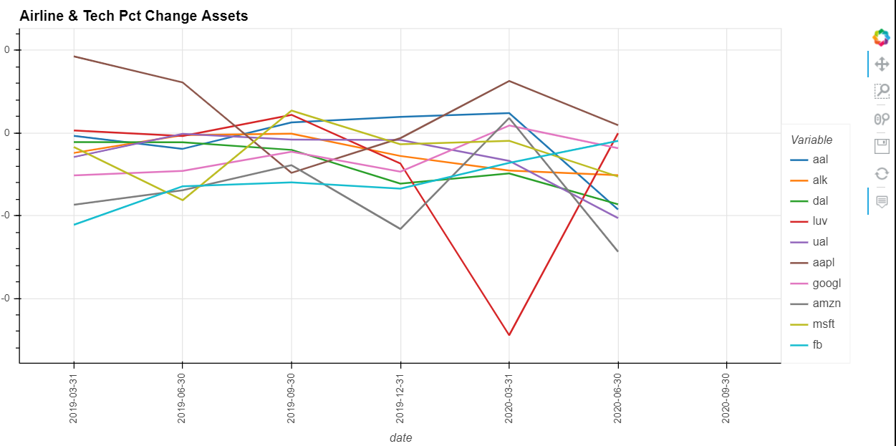

Slide 12
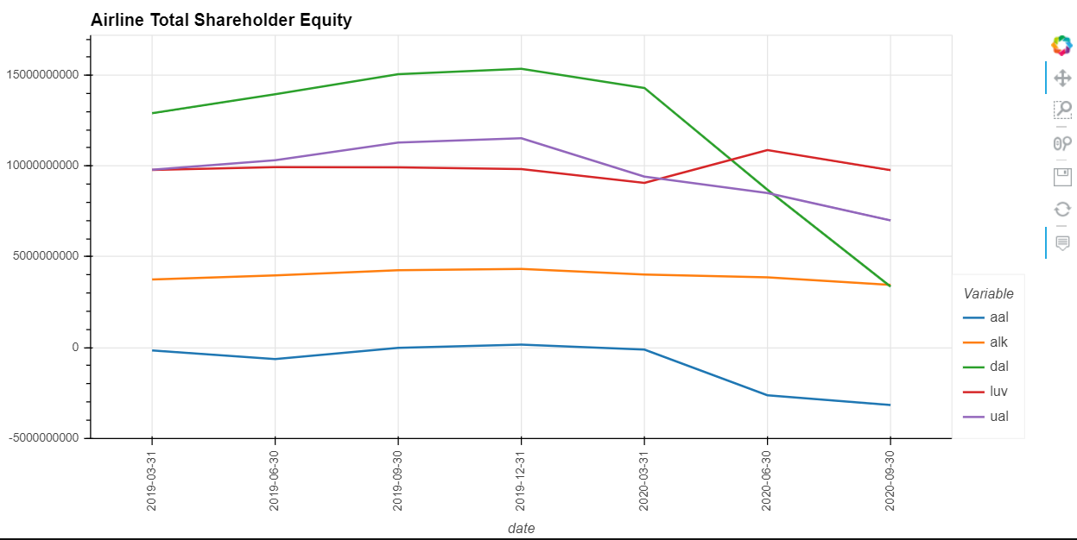

Slide 13
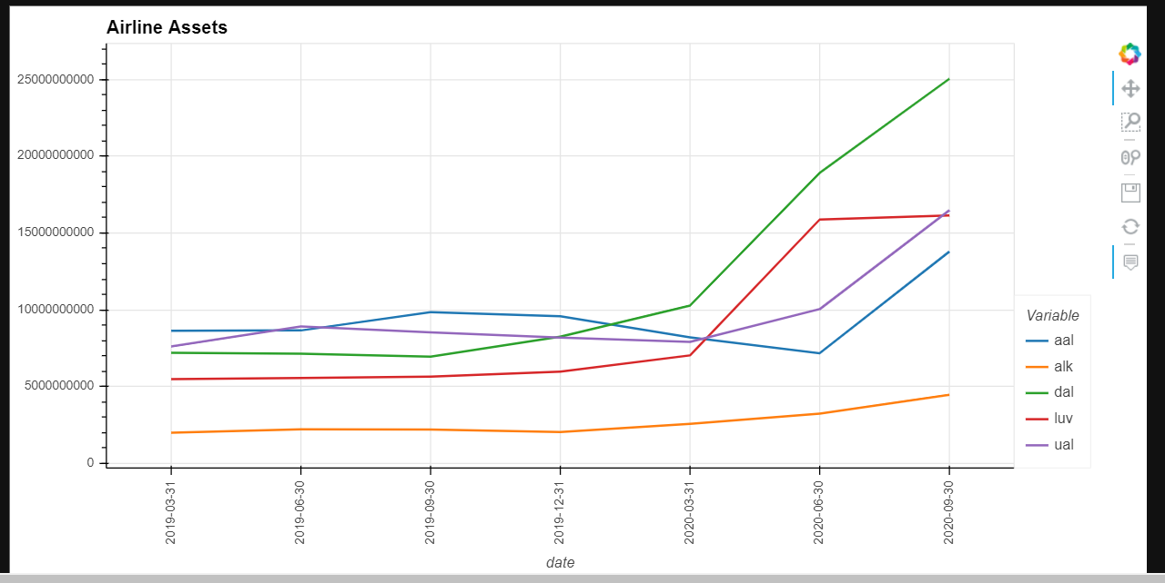

Slide 14
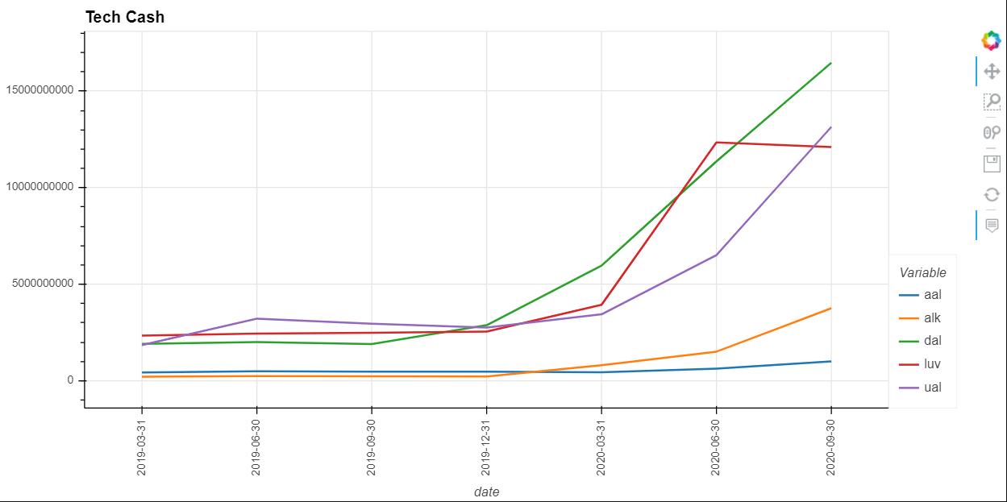

Slide 15
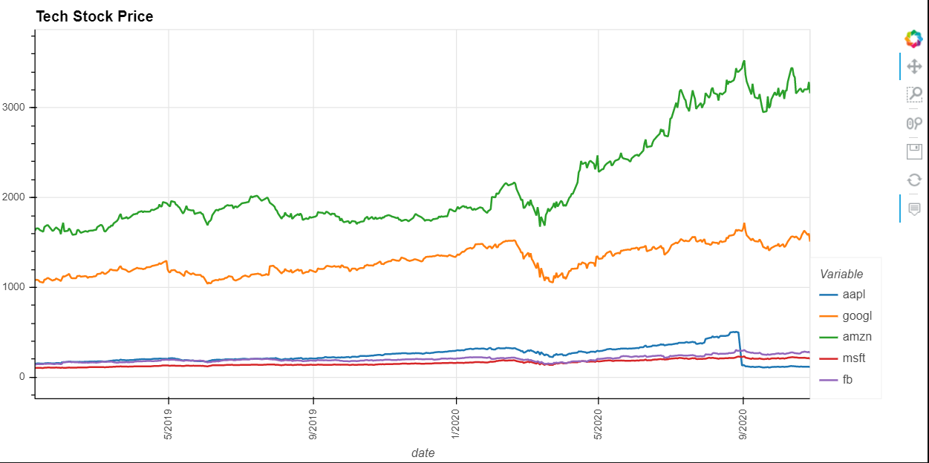

Slide 16
Conclusions (cont’d)
The project helped us answer following questions;
Where were the industries before Covid-19 pandemic?
According to airline association of North America, airlines were experiencing “Golden Age”. The conducted study showed that combination of newer planes, enhanced consumer touchpoints and appealing ticket value had propelled airlines to it’s highest point in history. America alone was entertaining 2.5 million travelers per day. As recent as in Jan. and Feb. 2020, American airline was increased approximately anywhere in between 5.5% to 6.5%.

Slide 17
How did covid-19 affect these industries? (cont’d)
Airlines saw their fall in late April 2020 when passenger volumes were down as low as 96% to historically low. U.S. airlines have grounded more than 3000 aircraft costing them collectively over $10 billion of cash per month.
American tech industry was already doing well before pandemic while making billions of dollars a year. Now that we’re on the serge for Covid cases, tech titans are at their new heights. Presently, Tech industry is dominating American businesses in a way we saw railroad era in late 1800s.
On the contrary, technology stocks elevated the S&P 500 stock index to a record high in August. The stocks of Apple, Facebook, Alphabet, Amazon and Microsoft rose proximately 37% in the first seven months in 2020. These organizations contributes 20% of the stock market’s total worth including Apple’s highest value that managed to reach $2 trillion.

Slide 18
What impact did it have on the overall market? (cont’d)
The overall market became volatile as pandemic progressed. Currently, airline industry is at its worst volatility, followed by Tech industry. Although, it would be safer to say that tech company is carrying the S&P 500’s majority of index.
Over all market became volatile as Pandemic progressed. However, tech companies are doing well for now.

Slide 19
What can each industry do next to sustain their business?
Our advice to airline industry is that they need cushion of more cash on hand to survive this pandemic by taking advantage of the relief opportunity provided in the CARES Act, accessing outside sources of cash like unsecured and secured loans, and cost cutting. For instance, rescinding issuance of dividends or stock repurchases, deferring aircraft deliveries to the extent negotiations with manufacturer, halting capital projects, negotiating vendors and airport partners to secure flexibility or relief on payment terms and timing, and securing voluntary unpaid leaves or salary reductions. Perhaps it would be rewarding to turn focus on sheltering domestic business by making consumer feel safe and building alliance with tech companies to provide better business-related services.
Although, tech industry is doing much better than airline industry, they can face problems if they don’t take preventative actions. For example, it becomes vital to account for uncertainty and fragile economy of an evolving pandemic. Diminishing business travels results in fewer client interactions, it can impact workforce with slower recruiting process can compromise pipeline of skilled workforce. Cyber security risks are higher with more employees working remotely.
Tech industry can avoid many of these issues by taking preventative steps and building cybersafe platforms to support remote employees. They can create framework for data analysis and decision-making. Airline was most volatile in the beginning of the pandemic and followed by tech. Nevertheless, both industries are at different wavelength.
Notes:
our analysis shows that there is significant changes in the market due to Covid-19. We have a long road ahead of us on the recovery. As for S&P 500 index, tech stock is the way to go for now and in future.

Slide 20
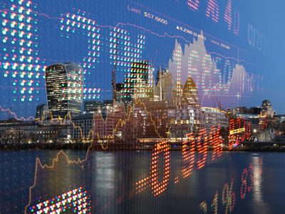
Any Questions???

